Slide 1

DEPARTMENT OF
ARTIFICIAL INTELLIGENCE AND DATA SCIENCE
ACADEMIC YEAR 2025 - 2026
SEMESTER III
ARTIFICIAL INTELLIGENCE LABORATORY
MINI PROJECT REVIEW
HMM Robot Localization Simulator: Visualizing Uncertainty
REGISTER NUMBER
NAME | Uday Kumar J.
YEAR | IInd
SECTION | “F”
FACULTY IN-CHARGE | Ms S. Divya

Slide 2
PROBLEM STATEMENT
Scenario: A robot on a 2D grid map with obstacles.
Challenges:
Probabilistic Movement: Robot's actions are imperfect (e.g., trying to move North might lead to slipping East).
Noisy Sensors: Robot's obstacle detectors are unreliable (false positives/negatives).
Hidden State: The robot's true location is unknown.
Goal:
Develop a Pygame simulator to visualize the HMM's ability to estimate the robot's location.
Represent the HMM's estimated location as a heatmap belief distribution.

Slide 3
THEORETICAL BACKGROUND
What is an HMM?
A statistical model for systems with unobserved (hidden) states and observable outputs.
Key Components:
States (S): Each possible grid cell location of the robot.
Observations (O): Sensor readings (4-bit binary for N, S, E, W obstacle detection).
Transition Model (T): P(S_t | S_{t-1}, Action). Probability of moving between states given an action.
Sensor (Emission) Model (E): P(O_t | S_t). Probability of observing O_t if the robot is truly in S_t.
Prior Probability (\pi): Initial belief distribution over states.
The Filtering Problem: Continuously compute the current belief Bel(S_t) = P(S_t | O_{1:t}, Action_{1:t}).

Slide 4
IMPLEMENTATION AND CODE
Link to code in Git-hub Repository
List | Git-hub Repository Links
Implementation of Code Link | Github.com/Ukoder/Robot_localization
Word Document Report Link | github.com/UKoder/Robot_localization
PPT Link | github.com/UKoder/Robot_localization-ppt

Slide 5
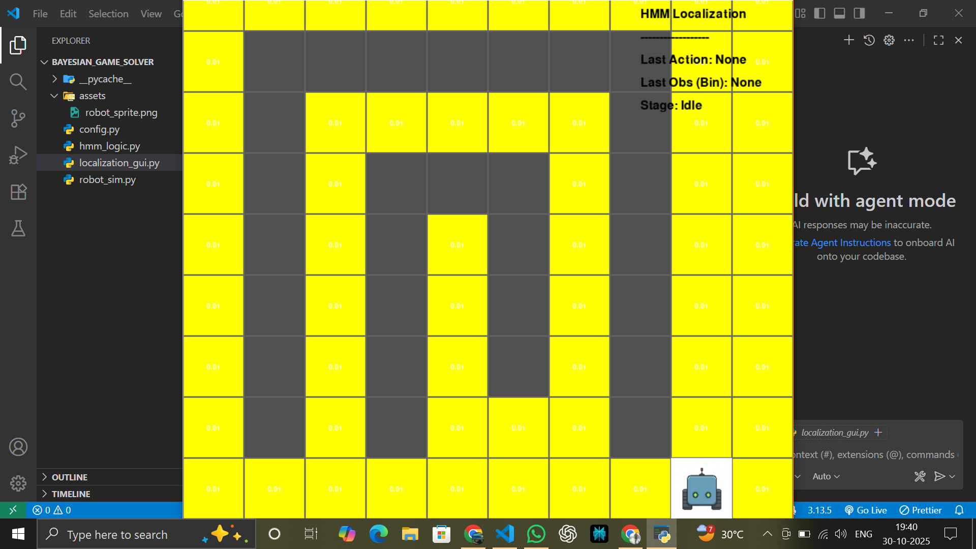
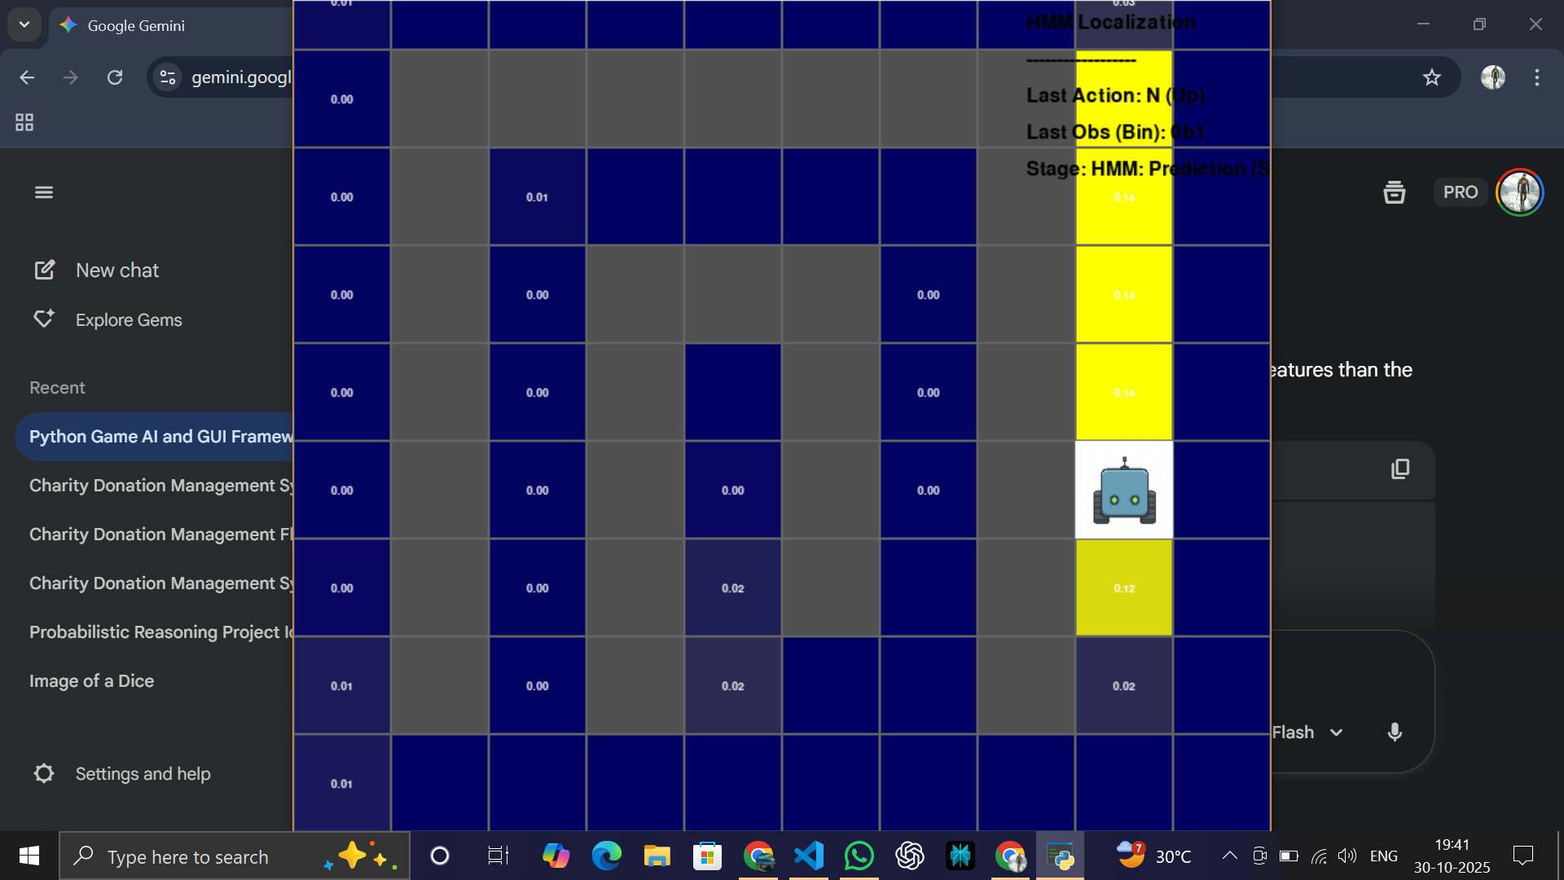
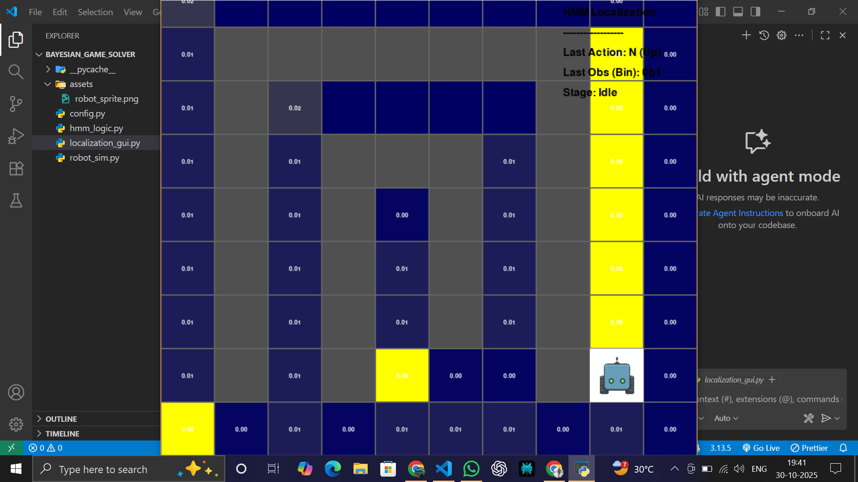
OUTPUT AND RESULTS

Slide 6
OUTPUT AND RESULTS
Screenshot 1: The robot begins with a uniform belief over all open cells. The heatmap shows equal probability everywhere, as the HMM has no information yet.
Screenshot 2: Description: After an action, the belief spreads to possible next states, reflecting increased uncertainty due to imperfect movement.
Screenshot 3: A noisy sensor observation focuses the belief, concentrating probability mass on locations consistent with the reading, ideally near the true robot.

Slide 7
REFERENCES
1. Russell, S. J., & Norvig, P. (2023). Artificial Intelligence: A Modern Approach (4th ed.). Pearson.
2. Thrun, S., Burgard, W., & Fox, D. (2005). Probabilistic Robotics. The MIT Press.

